Slide 1


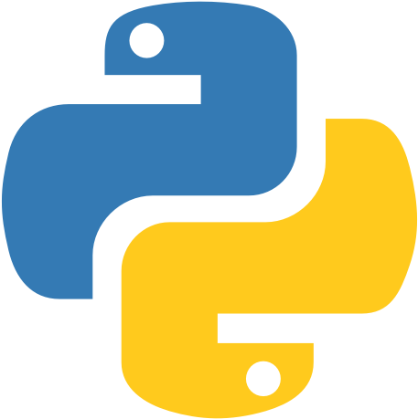
JumpingCatDesigns’ Instagram Post Scheduler
Create posts in advance easily!
Automate your Instagram posts!
Improve your SEO with incorporating tags!
Coder: Charlee fischer
Original code: Pramurta Sinha

